Slide 1
Enhancing Customer Comfort: Improving British Airways' Services

Slide 2
Customer Satisfaction Analysis
Present key findings:
Cabin staff service rated highly by customers.
Couple Leisure seats received superior ratings for comfort.
Inflight entertainment is crucial for customer satisfaction and recommendations.
Solo Leisure customers showed high overall service satisfaction

Slide 3
Improvement Strategies
A) Cabin Staff Service:
Invest in training and development programs.
Empower cabin crew to provide exceptional service.
B) Seat Comfort:
Upgrade seats or offer more Couple Leisure seats.
Focus on ergonomics and additional amenities.
C) Inflight Entertainment:
Enhance the range and quality of entertainment options.
Cater to various customer preferences.

Slide 4
Targeting Solo Leisure Customers
Leverage positive feedback from Solo Leisure segment.
Launch targeted marketing campaigns and special offers.
Strengthen customer engagement and loyalty.

Slide 5
Expected Benefits
Increased customer satisfaction and loyalty.
Positive word-of-mouth and more recommendations.
Attracting new customers and sustaining growth.

Slide 6
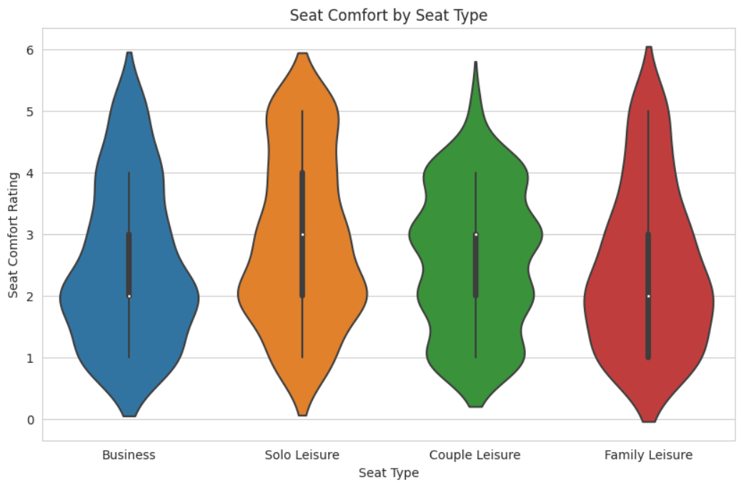
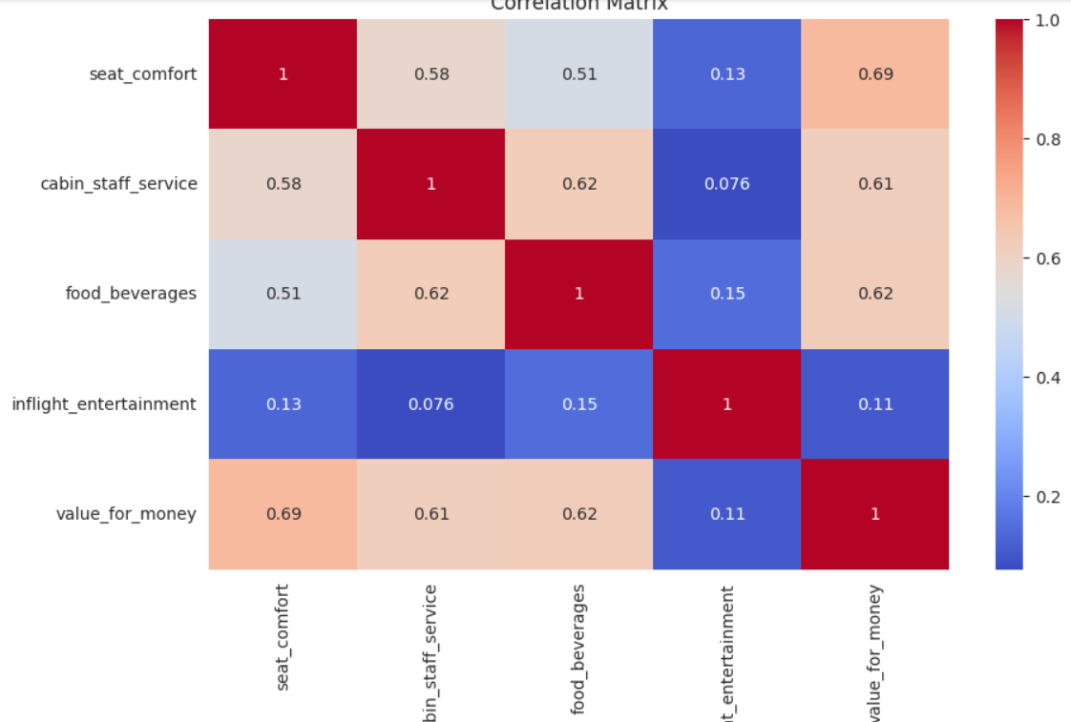
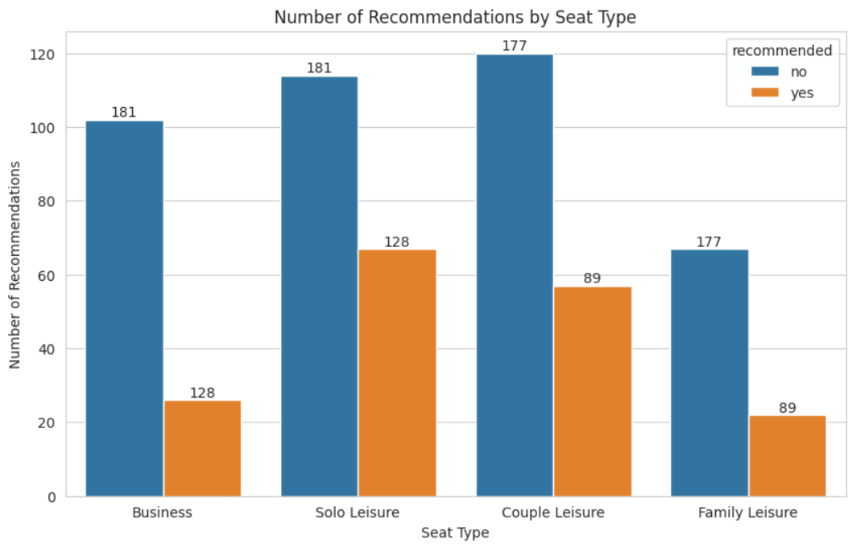
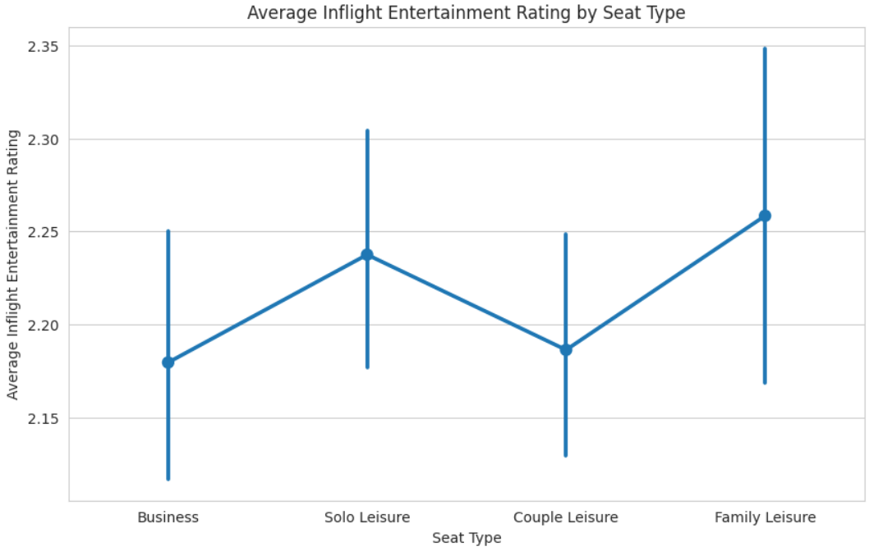
Visualized results

Slide 7
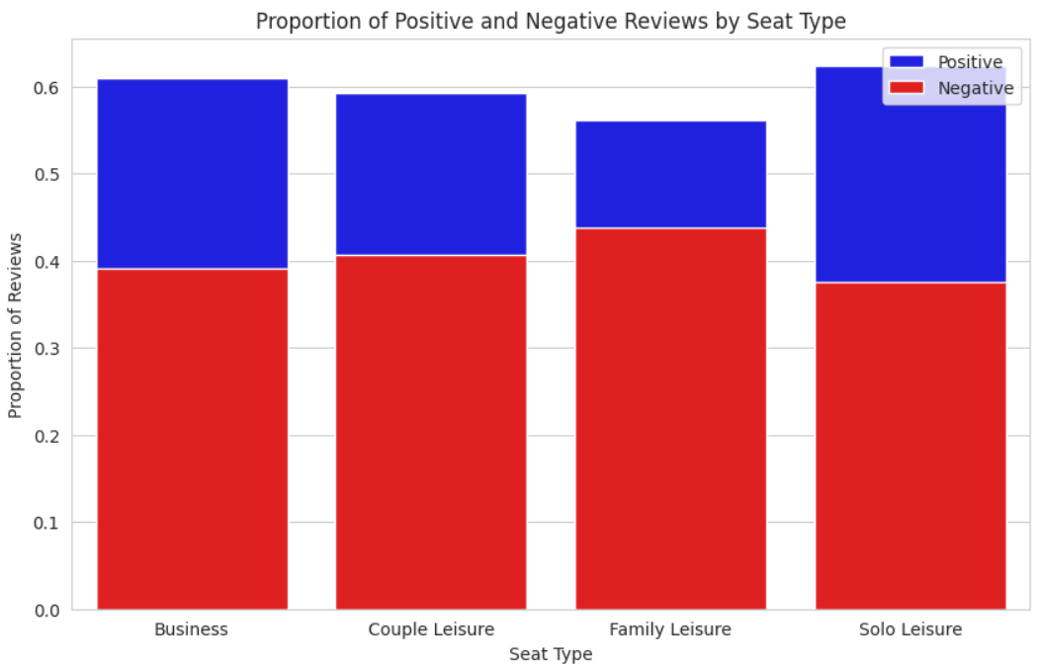
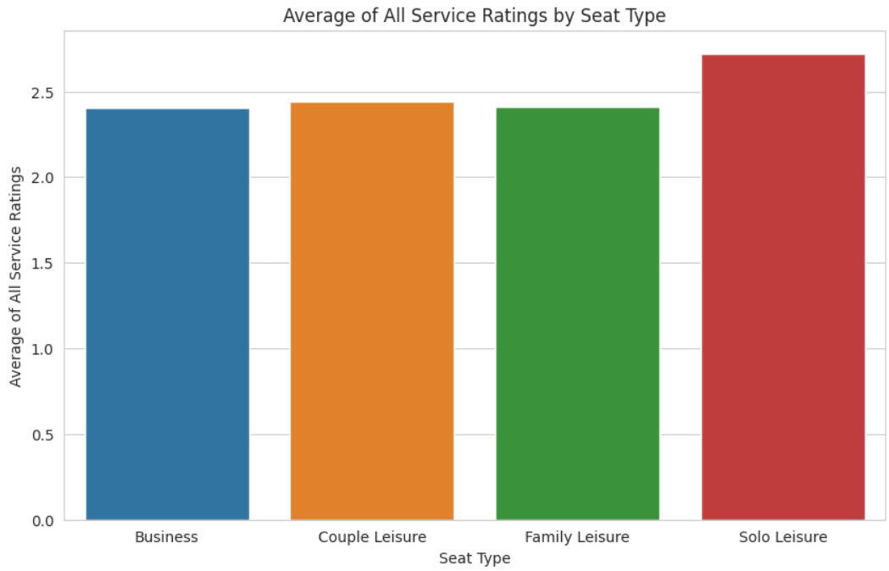
Visualized results

Slide 8
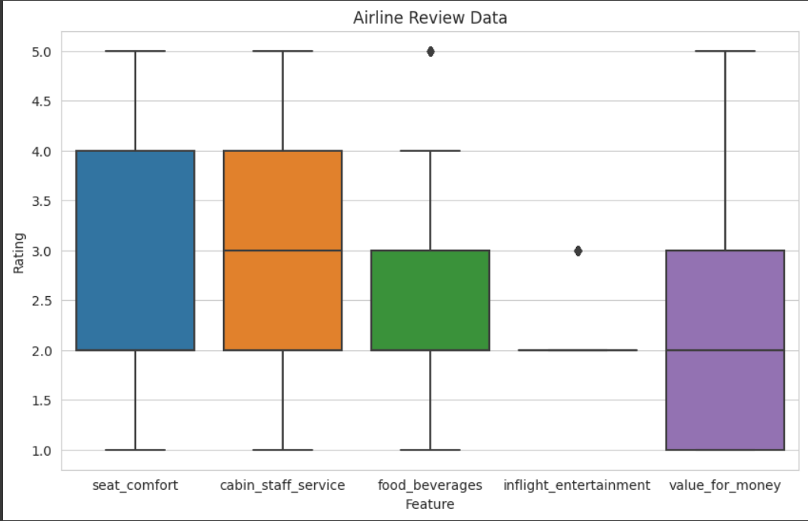
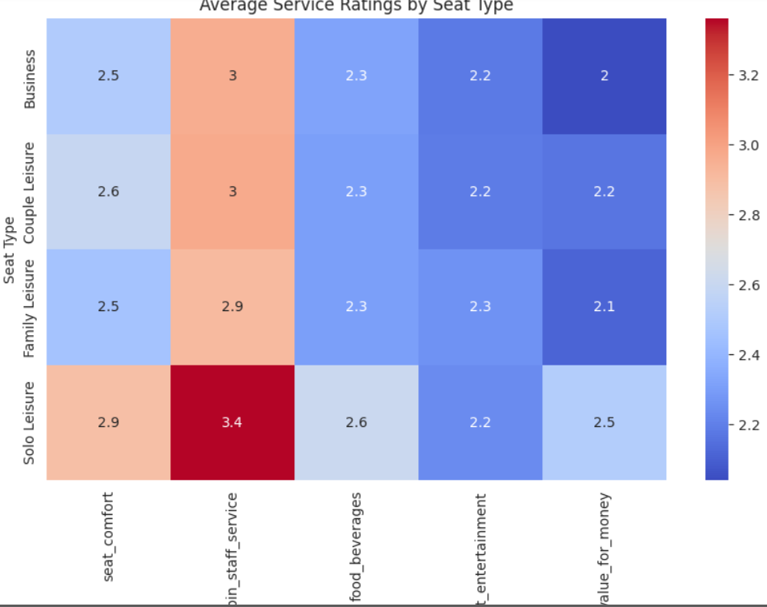
Visualized results

